Slide 1
College Degrees Part 2 & Midterm Reporting
College Prep
Mr. Gordon
jgordon@bisdtx.org

Slide 2
Upcoming Events
Weds. Oct. 12th 7PM Spring Break 2025 London, Paris, and the Alps Informational Meeting
St. Edward’s Sack Lunch Money Due $11
Oct. 14th ACC Midterms
Oct. 24-28 CRCA Spirit Week
hi

Slide 3
Midterm Advising
If you have already completed this, please ignore and go
to the next slide.
Every CRCA student received an email from Devon Miller in their ACC email. This is your midterm reporting sheet. Please use this time to complete this form. You can use Blackboard for grades. If you do not know your exact grades, do your best. This is mandatory.
If you have any questions, please see Mr. Gordon or Mr. Longoria.
hi

Slide 4
College Degree Levels
College degrees are divided into four categories:
Associate Degree
Bachelor’s Degree
Master’s Degree
Doctoral Degree
You will hear these terms used often at CRCA when discussing College and Career.
hi

Slide 5
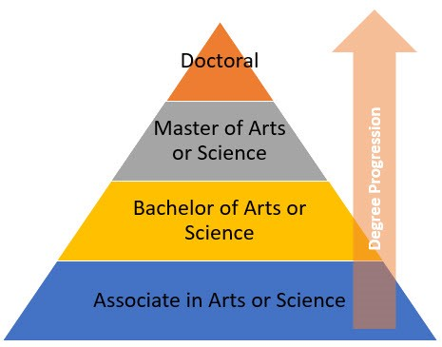
College Degree Levels
hi

Slide 6
Degree Overview
Only 13.1% of the US population has a Master’s or Doctorate degree.
Students who want to specialize in a certain field obtain their Master’s or Doctorate degree.
Some careers require a Master’s degree or higher,
such as College Professor, Doctor, and Lawyer.
Some careers require a Master’s if you want to supervise others or work at a higher level, such as education and engineering.
hi

Slide 7
Master’s Degree Overview
Must have already graduated with a Bachelor’s degree
Usually takes 2-3 years to complete
Must complete 30-36 credit hours
Can be completed at most universities
hi

Slide 8
Doctoral Degree Overview
This is the highest level of formal education
Must have a Bachelor’s and a Master’s degree
Can take 2-10 years
Requirements and hours vary greatly depending on field of study and university
hi

Slide 9
Why would I do that?
Even though it takes a few years.
There are some reasons to obtain a higher level of education:
To move up in your career
To make more money
To maintain your job
hi

Slide 10
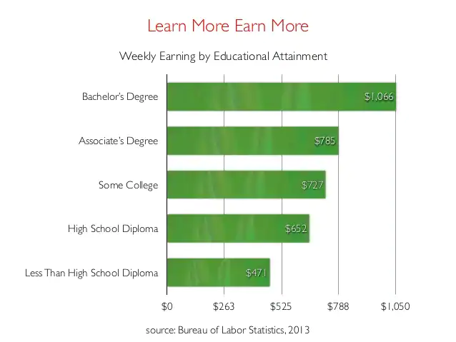
College Degree Levels
A person with a Bachelor’s degree on average earns $339 more a week than a person with just a high school diploma.
That is $17,628 a year and over half a million over 30 years of work.
hi

Slide 11
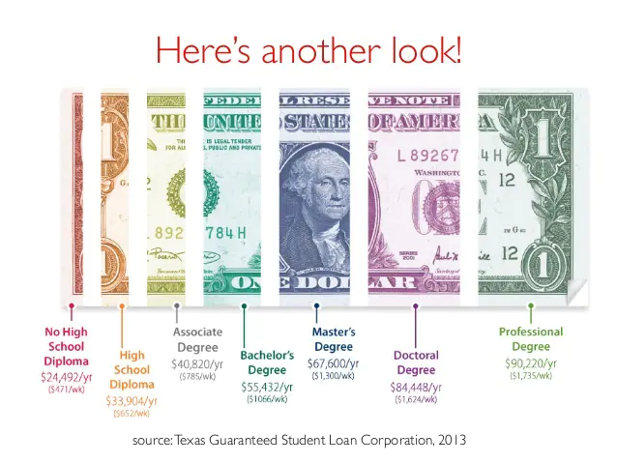
College Degree Levels
This is a look at the average yearly wage for a person with each education level.
hi

Slide 12
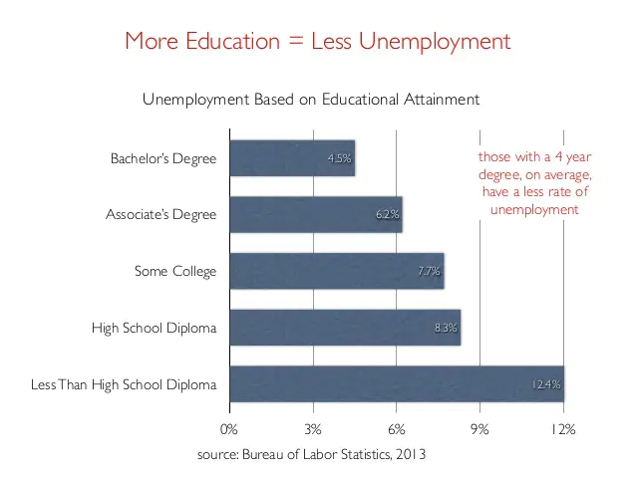
College Degree Levels
The more education you obtain the more likely you are to have a job.
The unemployment rate for a person with a Bachelor's degree is 4.5% compared to just a high school degree at 8.3%.
(This varies depending on the year.)
hi

Slide 13
Today’s College Prep Assignment
In the comments section of today’s College Prep,
answer the following question:
Using one of the majors you chose earlier, what degree does my future career require?
hi

